Slide 1
PIZZA HUT SALES ANALYSIS- SQL CASE STUDY
BY REDNAM YAMUNA

Slide 2
CONTENTS
ABOUT PIZZA HUT
PROBLEM STATEMENT
OBJECTIVE
BUSINESS CONTEXT
INTRODUCTION
DATA SET OVERVIEW
CASE STUDY QURIES
INSIGHTS
RECOMMENDATIONS
CONCLUSION

Slide 3
ABOUT PIZZA HUT
Pizza Hut was founded in 1958 by brothers Dan and
Frank Carney in Wichita, Kansas, with just $600. Their
small restaurant became famous for its cheesy pizzas
and welcoming atmosphere, leading to rapid
U.S. expansion.
By the 1970s, it had grown internationally,
introducing innovations like stuffed crust and pan
pizzas. Today, Pizza Hut stands as one of the world’s
largest pizza chains, serving millions of customers
globally.

Slide 4
PROBLEM STATEMENT
Pizza Hut aims to analyse its historical sales data to identify customer preferences, popular pizza types, and revenue patterns. With a wide
variety of orders and products, understanding key performance trends is challenging. This analysis will provide data-driven insights to enhance menu planning, optimize inventory, improve marketing strategies, and
increase overall profitability.

Slide 5
OBJECTIVE
The main objective of this project is to analyze Pizza Hut’s
sales data using SQL to derive meaningful insights into customer behavior, sales trends, and revenue performance. The analysis
helps identify top-selling pizzas, category contributions,
and peak sales periods, supporting data-driven business
decisions.
Specific objectives:
Clean and prepare the sales dataset for accurate analysis.
Identify top-selling pizzas and their revenue impact.
Analyze sales by category, size, and price range.
Determine peak sales times and days.
Evaluate category-wise revenue contribution using SQL techniques.

Slide 6
BUSINEES CONTEXT
In today’s competitive F&B sector, leveraging data is essential for
informed strategic decisions and enhanced customer experience.
Pizza Hut seeks to gain a comprehensive understanding of customer
preferences and sales trends through systematic data analysis.
SQL provides a robust framework to process and analyse large-
scale sales data, uncovering actionable insights.
Insights from sales patterns support optimized menu planning,
pricing strategies, and resource management.
This project demonstrates how data-driven intelligence can drive
operational efficiency, revenue growth, and business performance.

Slide 7
INTRODUCTION
This project analyses Pizza Hut’s sales data using SQL to generate actionable insights. Utilizing four CSV files detailing orders, pizzas, and categories, SQL queries uncover top-selling pizzas, revenue
trends, and customer preferences, enabling data-driven decisions to optimize business performance
menu planning, and operational efficiency.
Data set link :
https://drive.google.com/drive/folders/14IaODHUAeZX548A74cDEunsmNVL6znlc?usp= drive_link
orders.csv
order_details.csv
pizzas.csv
pizza_types

Slide 8
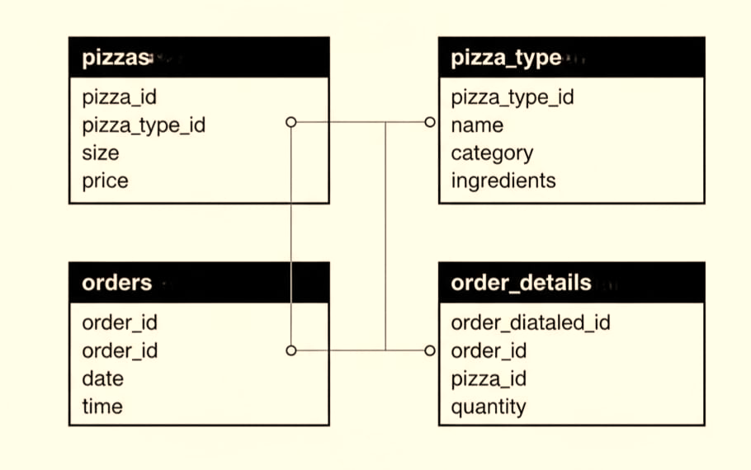
DATA SET OVERVIEW

Slide 9

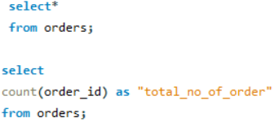
FROM BASICS TO BRILLIANCE : A STEPWISE SQL CASE STUDY ANALYSIS
BASIC ANALSIS
Output:
Total Orders Count
Query:
NOTE : Total orders reflect the overall demand and
customer engagement during the analysis period.

Slide 10

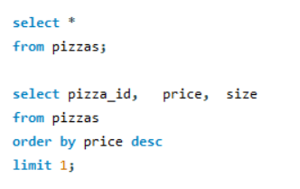
Most Expensive Pizza
Output:
Query:
NOTE : Highlights the premium pizza variant
with the highest price on the menu.

Slide 11
INSIGHTS:
Shows total orders placed, indicating overall sales volume.
Helps track customer activity and business growth.
Highlights the premium XXL pizza on the menu.
Shows potential revenue from high-value items.
Helps in pricing and promotion strategies.

Slide 12
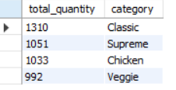
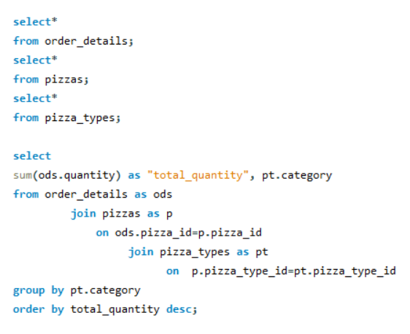
INTERMEDIATE ANALSIS
Pizza Quantity by Category
Output:
Query:
NOTE : Shows category-wise pizza demand to identify top-performing product segments

Slide 13
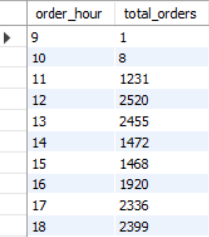
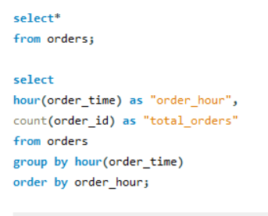
Order Trends by Hour of day
Output:
Query:
NOTE : Highlights hourly order trends to pin point
peak customer activity times.

Slide 14
INSIGHTS:
Classic pizzas are the most ordered category, so their ingredients
should be well-stocked.
Veggies pizzas have the lowest order quantity, likely due to limited
options; expanding varieties could boost sales.
Peak ordering times are lunch (12:00–13:00) and evening (17:00–19:00); early morning and late night have lower demand, allowing reduced
staffing

Slide 15
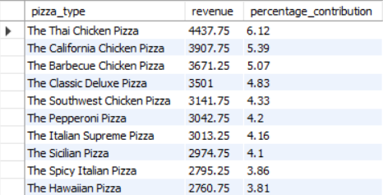
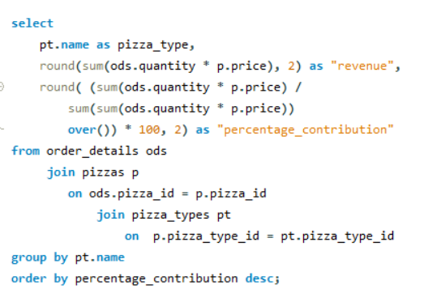
ADVANCE ANALSIS
Revenue Contribution by Pizza Type
Output:
Query:
NOTE : Displays revenue share of each pizza
type to identify the most profitable categories
and percentage contribution.

Slide 16
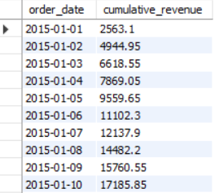
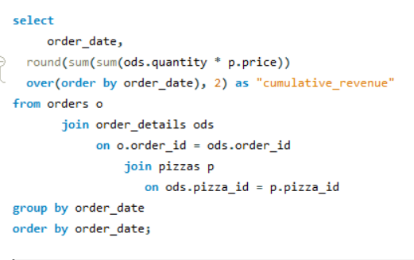
Cumulative Revenue Over Time
Output:
Query::
NOTE : Shows the cumulative revenue trend to assess overall sales performance and
growth over time.

Slide 17
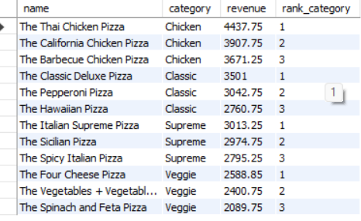
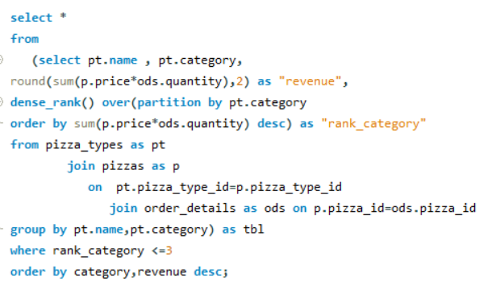
Top 3 Pizza Types by Revenue in Each Category
Output:
Query:
NOTE : Ranks pizzas by revenue
within each category to identify
top earners and focus areas.

Slide 18
INSIGHTS:
Chicken pizzas like TLI Barbeque and California contribute
the most to total revenue and are top-selling items.
Pizzas like The Brie Carre Pizza have lower sales and could benefit
from promotions or menu updates.
Daily sales are steadily increasing, reflecting strong
business growth and consistent customer demand.
Chicken pizzas like TLI Barbeque and California Chicken
Pizza generate the highest revenue, making them top-selling
items.
Veg and classic pizzas contribute moderately to revenue,
while some specialty pizzas have lower sales and may need
promotional focus.

Slide 19
RECOMMENDATIONS:
Promote top-selling chicken pizzas with deals and improve or phase out low-selling items.
Prioritize popular ingredients, introduce new Veggie pizzas to boost underperforming segments.
Align staff with peak hours, run targeted promotions, and highlight the premium XXL pizza for
brand value.

Slide 20
CONCLUSION:
This project analyzed Pizza Hut’s sales data using SQL to uncover insights into customer preferences,
revenue distribution, and sales trends. The analysis identified top-selling pizzas, high-performing categories, and periods of peak demand. Findings show that a few pizza types contribute significantly to total revenue, and cumulative sales exhibit steady growth with distinct peaks. Based on these insights, it is recommended
to focus marketing on high-revenue pizzas, plan promotions around busy periods, and optimize inventory
management. Overall, the project demonstrates how data-driven analysis can enhance profitability and
support informed business decisions.

Slide 21
THANK YOU

